Slide 1
Annual Average Residential Water Use - Municipal
CSIT 553: Exploratory data analysis
Cecilia kamau
Noah mengich
Tinotenda muchenje

Slide 2
Dataset Description
Source:
Massachusetts Department of Environmental Protection (MassDEP), MA
Dataset name;
Residential Gallons per Capita Day (rgpcd)
Retrieved from data catalog;
https://datacommon.mapc.org/browser/datasets/260
Description:
Average Annual Water Demand from Public Water Suppliers that have been reviewed by MassDEP.
Residential Gallons per Capita Day is the average number of gallons used per resident per day between 2009 and 2015.
Massachusetts state standard water consumption 65 gal/capita/day.
The scope of the project includes;
Exploratory data analysis
Descriptive statistics and data visualization
Description of design involved, including idioms, marks and channels
Python program codes used in the project

Slide 3
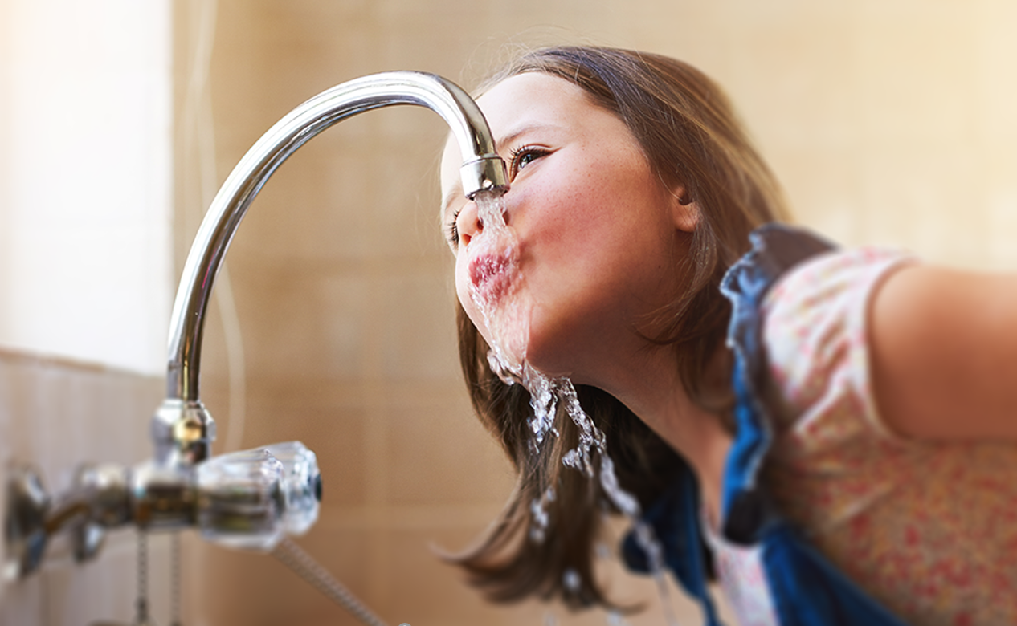
Objectives
The research project seeks to analyze annual residential water gallon demand and consumption per day over a period of seven years.
To discover patterns and relationship between water in gallons demanded, socioeconomic factors, municipal location details impacting residential water consumption behavior in the Massachusetts, US
To conduct data importation, preprocessing, and the exploratory data analysis (EDA) using Python; analyzing and visualizing the relationship of variables and impact on the residential water consumption

Slide 4
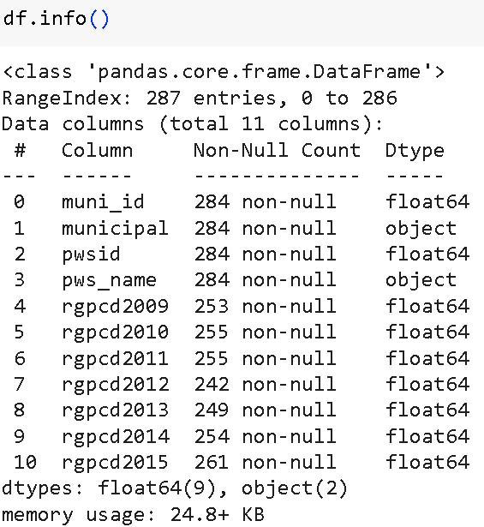
Importing libraries, Dataset loading, Understanding dataset and Cleaning
# Import libraries
import pandas as pd
import numpy as np
import matplotlib.pyplot as plt
import seaborn as sns
# Load municipal water use dataset
path = r"/content/annual_average_residential_water_use(municipal).csv"
df = pd.read_csv(path)
#Understanding the dataset
df.head()
id | munipal | pwsid | pws_name | rgpcd2009 | rgpcd2010 | rgpcd2011 | rgpcd2012 | rgpcd2013 | rgpcd2014 | rgpcd2015
0 | Abington | 4001000.0 | ABINGTON & ROCKLAND JT WATER WORKS | 61.0 | 64.0 | 62.0 | 68.0 | 59.0 | 64.0 | 63.0
1 | Acton | 2002000.0 | ACTON WATER DISTRICT | 55.0 | 55.0 | 56.0 | 55.0 | 56.0 | 54.0 | 60.0
2 | Acushnet | 4003000.0 | ACUSHNET WATER DEPARTMENT | 53.0 | 72.0 | 70.0 | NaN | 60.0 | 52.0 | 50.0
3 | Adams | 1004000.0 | ADAMS FIRE DISTRICT | 56.0 | 55.0 | 73.0 | 59.0 | 55.0 | 54.0 | 56.0
4 | Agawam | 1005000.0 | AGAWAM WATER DEPARTMENT | 60.0 | 78.0 | 75.0 | 75.0 | 75.0 | 66.0 | 70.0

Slide 5
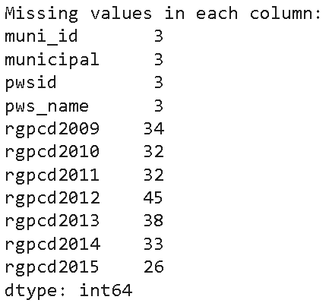
…Importing libraries, Dataset loading, Understanding dataset and Cleaning
#Data cleaning
#Check for missing values in each column
missing_values = df.isnull().sum()
print("Missing values in each column:")
print(missing_values)
#Missing categorical data ['Municipality', 'Public Water Supply Name']
#Filling for Categorical
categorical_columns = ['municipal', 'pws_name']
# Fill in the missing values with 'Unknown'
df[categorical_columns] = df[categorical_columns].fillna("Unknown")
# Change 'municipal' and 'pws_name' to camel case
df['municipal'] = df['municipal'].str.title()
df['pws_name'] = df['pws_name'].str.title()
# Fill in the missing values using median imputation
# List of numerical columns to impute
numerical_columns = ['rgpcd2009', 'rgpcd2010', 'rgpcd2011', 'rgpcd2012', 'rgpcd2013', 'rgpcd2014', 'rgpcd2015']
# Impute missing values with the median
df[numerical_columns] = df[numerical_columns].fillna(df[numerical_columns].median())
df.head()
id | munipal | pwsid | pws_name | rgpcd2009 | rgpcd2010 | rgpcd2011 | rgpcd2012 | rgpcd2013 | rgpcd2014 | rgpcd2015
0 | Abington | 4001000.0 | ABINGTON & ROCKLAND JT WATER WORKS | 61.0 | 64.0 | 62.0 | 68.0 | 59.0 | 64.0 | 63.0
1 | Acton | 2002000.0 | ACTON WATER DISTRICT | 55.0 | 55.0 | 56.0 | 55.0 | 56.0 | 54.0 | 60.0
2 | Acushnet | 4003000.0 | ACUSHNET WATER DEPARTMENT | 53.0 | 72.0 | 70.0 | NaN | 60.0 | 52.0 | 50.0
3 | Adams | 1004000.0 | ADAMS FIRE DISTRICT | 56.0 | 55.0 | 73.0 | 59.0 | 55.0 | 54.0 | 56.0
4 | Agawam | 1005000.0 | AGAWAM WATER DEPARTMENT | 60.0 | 78.0 | 75.0 | 75.0 | 75.0 | 66.0 | 70.0
Notes:
Data cleaning stage entails checking the missing values for ease analysis and visualization. We will either fill with the mean of the specified column (if quantitative values) or drop altogether.

Slide 6
Data Analysis using Descriptive Statistics
Key Observation and Summary
Count: For all the dataset columns, there are 287 rows
Mean: rgcp annual mean ranges from a low of 56.59 (in 2014) to a high of 60.6 (in 2010). Hence, there consistency in water usage over the years
Std: The variability of the values ranged from around 10 to 13 across the years, indicating moderate differences in daily water usage per capita among municipalities
Min./Max. Water usage ranges widely, from as low as 22 gallons to as high as 127 gallons per capita per day.
Percentiles (25%, 50%, 75%): Half of the municipalities used between 50 to 65 gallons, indicating most are within a similar range.
# Get descriptive statistics summary for all numerical columns
df.describe()
 | rgpcd2009 | rgpcd2010 | rgpcd2011 | rgpcd2012 | rgpcd2013 | rgpcd2014 | rgpcd2015
count | 287.000000 | 287.000000 | 287.000000 | 287.000000 | 287.000000 | 287.000000 | 287.000000
mean | 57.421603 | 60.679443 | 57.672822 | 57.965157 | 57.177700 | 56.595819 | 58.372822
std | 10.089458 | 11.652082 | 10.545686 | 11.480243 | 11.040285 | 11.921233 | 13.116358
min | 24.000000 | 23.000000 | 24.000000 | 22.000000 | 29.000000 | 29.000000 | 25.000000
25% | 52.000000 | 54.000000 | 52.000000 | 52.000000 | 52.000000 | 50.000000 | 51.000000
50% | 57.000000 | 60.000000 | 56.000000 | 57.000000 | 56.000000 | 55.000000 | 57.000000
75% | 61.000000 | 65.000000 | 62.000000 | 62.000000 | 61.000000 | 61.000000 | 63.000000
max | 96.000000 | 109.000000 | 100.000000 | 119.000000 | 113.000000 | 113.000000 | 127.000000
Notes:
The summary of the dataset assesses the distribution and variability of residential water usage across various municipalities over several years. A stable mean and median suggest consistent water use patterns, though the increasing maximum values in later years could indicate growing variability or outliers.

Slide 7
… Descriptive Statistics
Skewness
Values range from 0.59 to 1.71, indicating a right-skewed distribution each year. This suggests that there are more municipalities with lower water usage, but a few have much higher usage.
Kurtosis
Ranging from 1.97 to 5.98, the kurtosis values above 3 (especially in 2012, 2013, 2014, and 2015) indicate a leptokurtic distribution. This means the data have more pronounced peaks and heavier tails, implying more extreme values or outliers.
Range
The range of values (difference between max and min) increases from 72 in 2009 to 102 in 2015, showing a growing variability in water usage across municipalities over time.
 | Year | Skewness | Kurtosis | Range
0 | 2009 | 0.589686 | 1.967029 | 72.0
1 | 2010 | 1.018202 | 2.639282 | 86.0
2 | 2011 | 0.750911 | 2.337538 | 76.0
3 | 2012 | 1.513220 | 5.677169 | 97.0
4 | 2013 | 1.399925 | 4.337829 | 84.0
5 | 2014 | 1.404606 | 4.202961 | 84.0
6 | 2015 | 1.713229 | 5.980910 | 102.0
Notes:
Skewness : measures the asymmetry of the distribution of data points around the mean. It indicates whether the data is skewed to the left (negative skew) or to the right (positive skew).
Kurtosis : measures the "tailedness" of the distribution. It indicates how heavy or light the tails of the distribution are compared to a normal distribution.
Range : is the difference between the maximum and minimum values in a dataset. It provides a simple measure of variability.

Slide 8
… Descriptive Statistics
IQR (Interquartile Range)
The IQR, measures the spread of the middle 50% of data, varies between 9.0 and 12.0. A higher IQR (e.g., in 2015) indicates more variability in water usage.
Lower and Upper Bounds
The bounds are used to detect outliers. Values below the Lower Bound and above the Upper Bound are considered outliers. The bounds range from approximately 33.0 to 38.5 (lower) and 74.5 to 81.5 (upper) across the years.
Total Outliers
The number of detected outliers per year decreases from 22 in 2009 to 12 in 2015. This suggests that, although there is increasing variability, fewer extreme outliers are identified in later years, potentially due to changes in water usage patterns.
 | Year | IQR | Lower Bound | Upper Bound | Total Outliers
0 | 2009 | 9.0 | 38.5 | 74.5 | 22
1 | 2010 | 11.0 | 37.5 | 81.5 | 19
2 | 2011 | 10.0 | 37.0 | 77.0 | 17
3 | 2012 | 10.0 | 37.0 | 77.0 | 21
4 | 2013 | 9.0 | 38.5 | 74.5 | 25
5 | 2014 | 11.0 | 33.5 | 77.5 | 16
6 | 2015 | 12.0 | 33.0 | 81.0 | 12

Slide 9
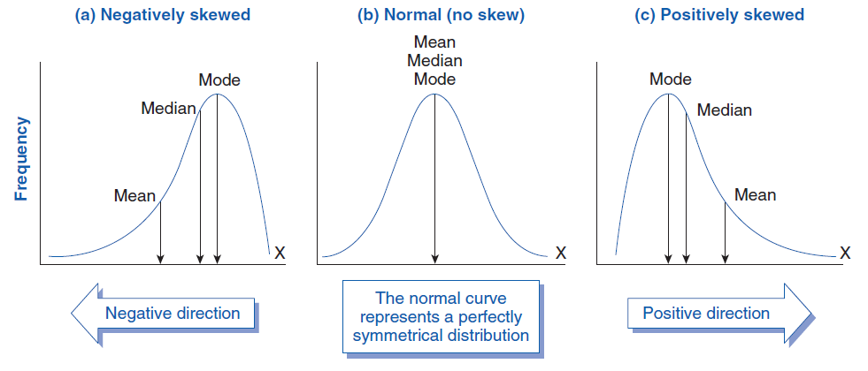
… Descriptive Statistics
Summary
Overall, water usage is stable but shows some increasing variability and occasional high outliers.
Mean rgpcd: Consistent at 57-60 gallons per day.
Variability: Standard deviation around 10-13; moderate spread.
Range: Usage varies widely, with a max of 127 and min of 22 gallons.
Skewness & Kurtosis: Right-skewed with some extreme values, especially in later years.
Outliers: 12-25 detected annually, decreasing over time.
Notes:
Overall, water usage is stable but shows some increasing variability and occasional high outliers.

Slide 10
Data Manipulation
Data Wrangling
We reshaped the data using melt() to convert the dataset from a wide format to a long format. It allows one column for the year and another for the corresponding water usage values.
# Step 1: Reshaping Data using melt
# Assume the first four columns are identifiers and the rest are years
id_vars = ['muni_id', 'municipal', 'pwsid', 'pws_name']
value_vars = ['rgpcd2009', 'rgpcd2010', 'rgpcd2011', 'rgpcd2012', 'rgpcd2013', 'rgpcd2014', 'rgpcd2015']
# Melt the DataFrame
melted_df = pd.melt(df, id_vars=id_vars, value_vars=value_vars,
var_name='Year', value_name='Water_Usage')
# Creating New Columns
# Extract the year from the 'Year' column
melted_df['Year'] = melted_df['Year'].str.extract('(\d+)').astype(int)
# Create the Above_Benchmark column
melted_df['Above_Benchmark'] = melted_df['Water_Usage'] > 65
 | muni_id | municipal | pwsid | pws_name | Year | Water_Usage | Above_Benchmark
0 | 1 | Abington | 4001000 | Abington & Rockland Jt Water Works | 2009 | 61.0 | False
1 | 2 | Acton | 2002000 | Acton Water District | 2009 | 55.0 | False
2 | 3 | Acushnet | 4003000 | Acushnet Water Department | 2009 | 53.0 | False
3 | 4 | Adams | 1004000 | Adams Fire District | 2009 | 56.0 | False
4 | 5 | Agawam | 1005000 | Agawam Water Department | 2009 | 60.0 | False

Slide 11
… Data Manipulation
Data Aggregation
Group by Municipality
We will calculate the average, median, and total water usage per municipality. We'll also check for municipalities that consistently exceed or fall below the state standard of 65 gallons per capita per day.
# Group by Municipality
municipality_stats = melted_df.groupby('municipal').agg(
average_usage=('Water_Usage', 'mean'),
median_usage=('Water_Usage', 'median'),
total_usage=('Water_Usage', 'sum')
).reset_index()
# Identify municipalities that consistently exceed or fall below the state standard
municipality_stats['Above_Benchmark'] = melted_df.groupby('municipal')['Above_Benchmark'].apply(lambda x: (x.sum() == len(x))).reset_index(drop=True)
# Display municipality statistics
municipality_stats.head()
 | municipal | average_usage | median_usage | total_usage | Above_Benchmark
0 | Abington | 63.000000 | 63.0 | 441.0 | False
1 | Acton | 55.857143 | 55.0 | 391.0 | False
2 | Acushnet | 59.142857 | 57.0 | 414.0 | False
3 | Adams | 58.285714 | 56.0 | 408.0 | False
4 | Agawam | 71.285714 | 75.0 | 499.0 | False

Slide 12
… Data Manipulation
Yearly Municipality Annual Average and Total Water Usage
Calculate annual averages for all municipalities combined to analyze state-level trends over the years.
Aggregate data to find yearly trends, such as total water use across all municipalities for each year.
# Calculate Annual Averages
annual_avg = melted_df.groupby('Year').agg(annual_average=('Water_Usage', 'mean')).reset_index()
# Calculate Total Water Usage
total_water_usage = melted_df.groupby('Year').agg(total_water_usage=('Water_Usage', 'sum')).reset_index()
# Merge Annual Average and Total Water Usage
yearly_data = pd.merge(annual_avg, total_water_usage, on='Year')
# Display the combined DataFrame
print("Yearly Data (Annual Average and Total Water Usage):")
yearly_data
 | Year | annual_average | total_water_usage
0 | 2009 | 57.421603 | 16480.0
1 | 2010 | 60.679443 | 17415.0
2 | 2011 | 57.672822 | 16552.1
3 | 2012 | 57.965157 | 16636.0
4 | 2013 | 57.177700 | 16410.0
5 | 2014 | 56.595819 | 16243.0
6 | 2015 | 58.372822 | 16753.0
Notes:
The code calculates summary statistics for each municipality:
Average, Median, and Total water usage.
It flags municipalities that consistently exceed the state benchmark using the Above_Benchmark column.
This identifies high-usage municipalities and those consistently above standard limits.

Slide 13
… Data Manipulation
comparison = melted_df.groupby('municipal').agg(
average_usage=('Water_Usage', 'mean'),
total_usage=('Water_Usage', 'sum')
).reset_index()
# Identify highest and lowest average water usage municipalities
highest_usage = comparison.loc[comparison['average_usage'].idxmax()]
lowest_usage = comparison.loc[comparison['average_usage'].idxmin()]
print("\nHighest Average Water Usage Municipality:")
print(highest_usage)
print("\nLowest Average Water Usage Municipality:")
print(lowest_usage)
Comparison - Minimum and Maximum Water Usage by Municipality
Entails aggregating data to compare different municipalities, identifying those with the highest and lowest average water usage.
Water Usage per Municipality
Highest Average |  | Lowest Average
municipal | Weston | municipal | Lowell
average_usage | 108.4286 | average_usage | 30.85714
total_usage | 759 | total_usage | 216
Name: 246, dtype: object |  | Name: 114, dtype: object

Slide 14
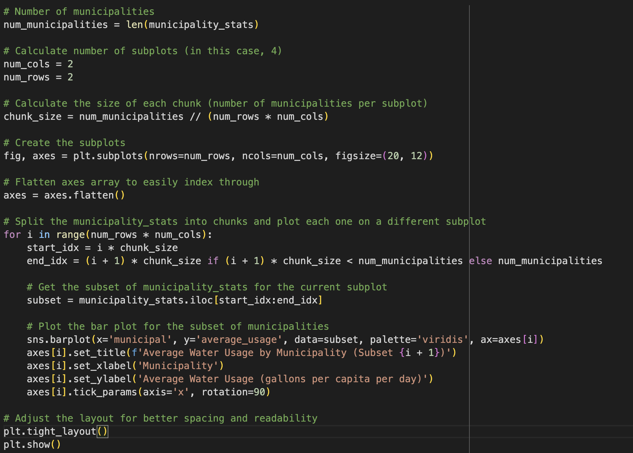
Data Visualization
1. Bar Plot of Average water Usage by Municipality
It gives a quick visual comparison of the average water usage across municipalities .
The data was sub-divided into subplots for easier visualization.
Bar graph compares average water usage across municipalities, using the following visualization tools:
Markers: Each bar’s length represents water usage, allowing clear comparison across municipalities.
Channels:
Position (bar height) shows average usage values.
Color (Viridis palette) distinguishes municipalities and enhances readability without clutter.
Axes and Labels: The x-axis lists municipalities with rotated labels for readability; the y-axis displays average usage in gallons per capita per day.
Subplots: The 2x2 grid divides the data into subsets for better clarity, preventing overcrowding and maintaining legibility across all municipalities.

Slide 15
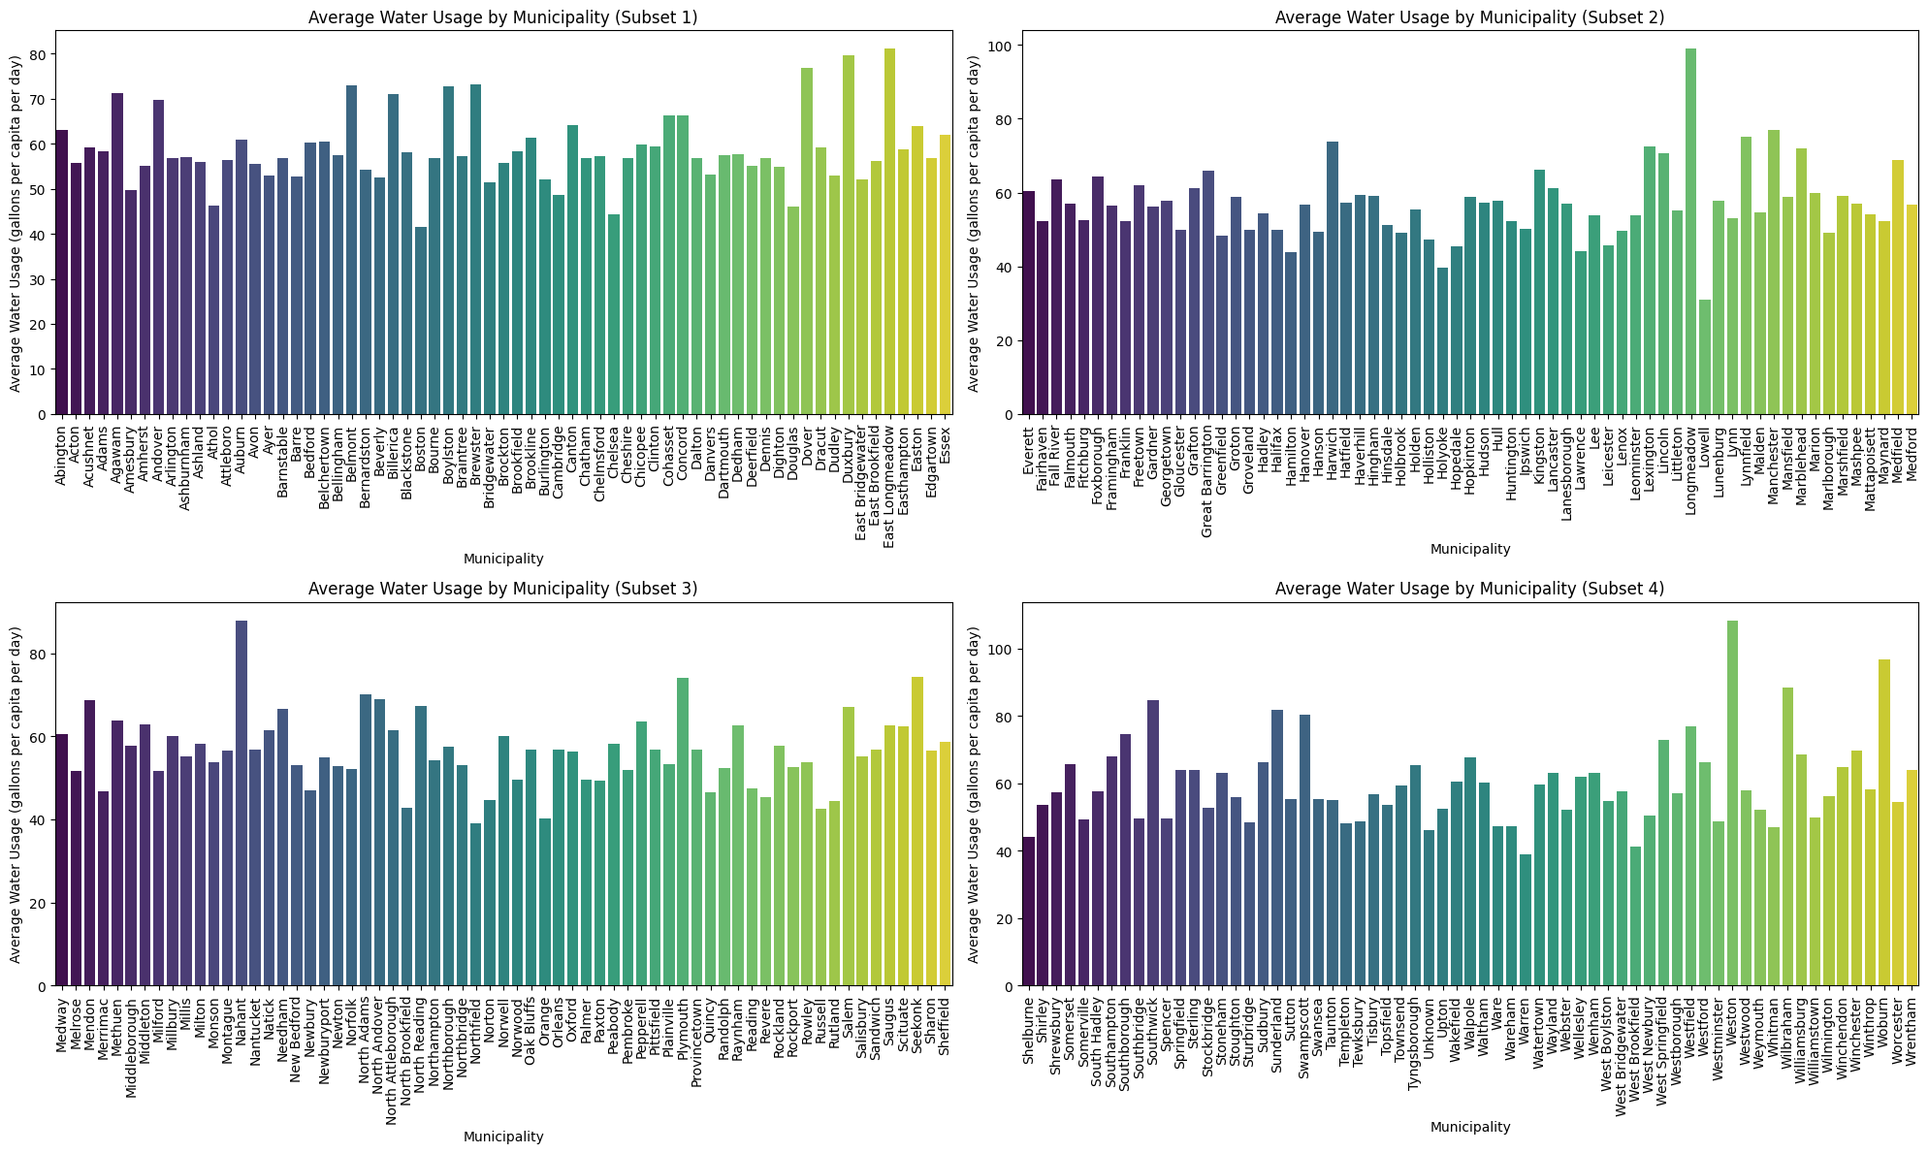
Bar Graphs of Municipalities

Slide 16
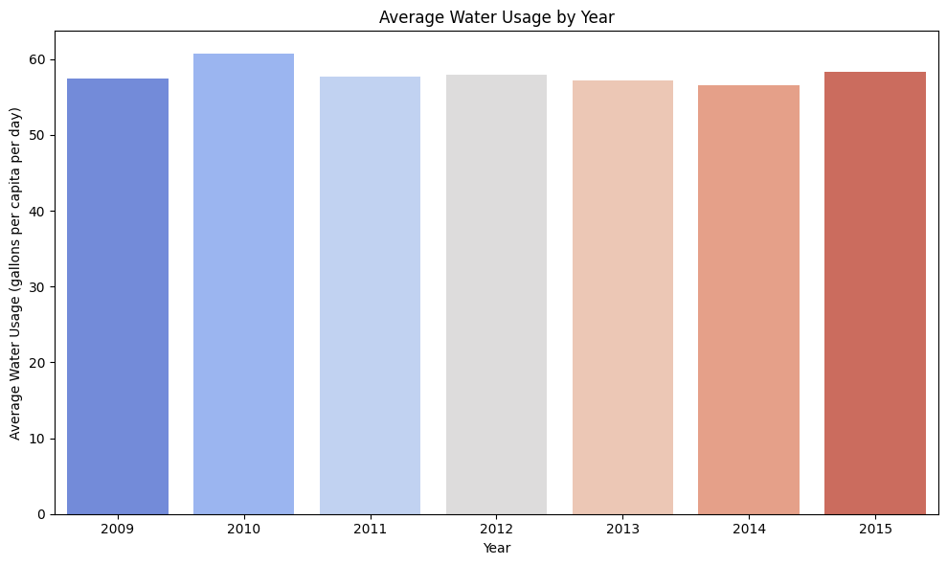
Bar Plot for average water usage per year
This bar graph shows the average water usage per capita per day from 2009 to 2015, with minor year-to-year variations:
2009–2010 Increase: Water usage slightly rises from 2009 to 2010, reaching a peak.
2011 Drop: There’s a slight decrease in 2011, followed by consistent levels in 2012–2014.
2015 Rise: Water usage increases slightly again in 2015.
Markers and Channels:
Bars represent each year’s average, allowing easy comparison.
Position (Vertical) indicates usage levels.
Color Gradient (Coolwarm Palette) emphasizes subtle shifts across years.

Slide 17
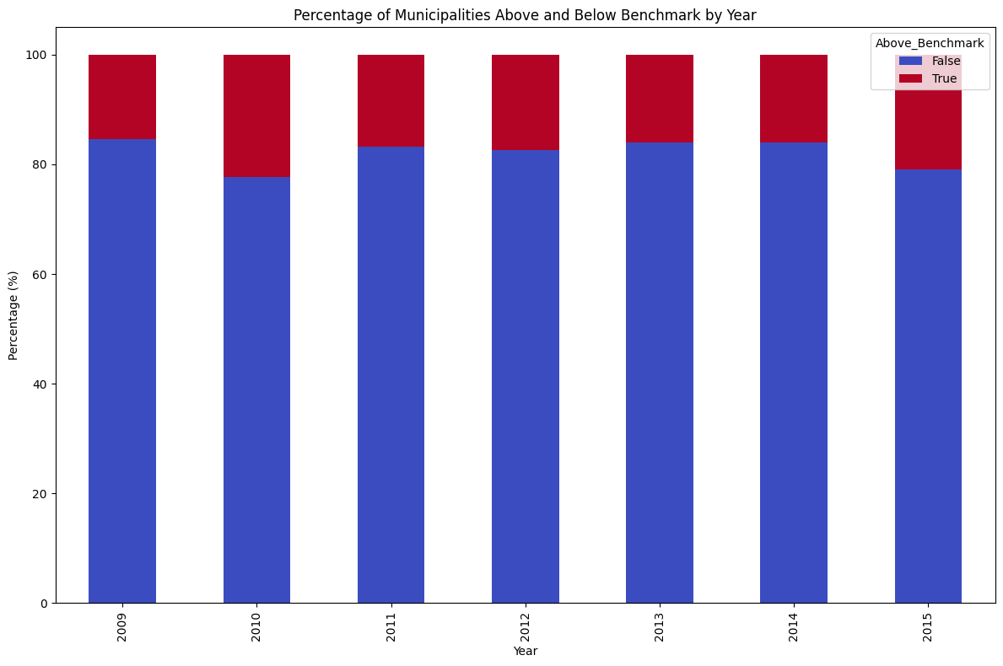
Bar Graph-Percentage of municipalities Above and Below benchmark per year
Overview:
Above Benchmark (Red): Percentage of municipalities above the benchmark gradually increases from 2009 to 2015.
Below Benchmark (Blue): Correspondingly, the percentage below the benchmark shows a slight decrease.
Key Insights:
Increasing Trend: More municipalities meet or exceed the benchmark over time, suggesting possible improvements in water management.
Yearly Division: Consistent split each year between those above and below the benchmark, with a gradual shift toward municipalities meeting and exceeding the benchmark.
Visual Highlights:
Color-Coding: Red for above, blue for below to clearly show trends.
Implications: Reflects positive shifts in municipal performance .(More municipalities are meeting the benchmark)

Slide 18
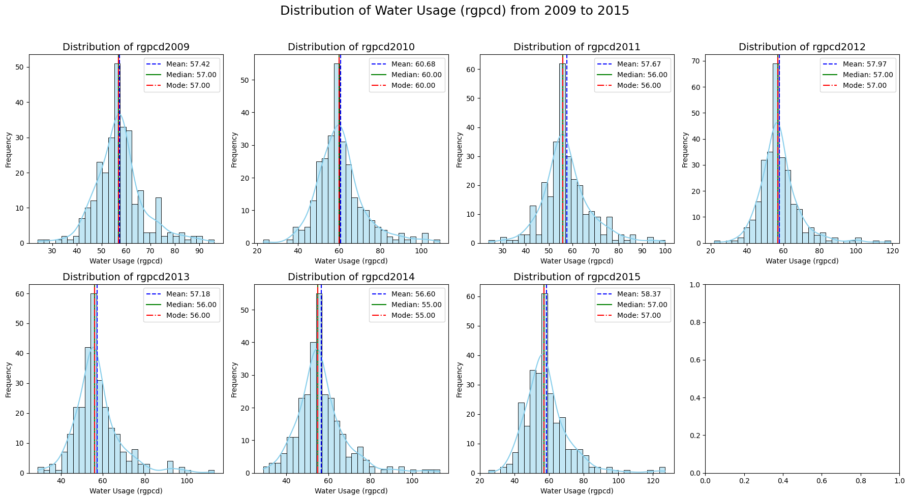
2. Histogram and the Distribution curve
Notes:
Shape of Distribution:
Each histogram displays a right-skewed distribution, as evidenced by a longer tail on the right. This indicates that most municipalities have moderate water usage, but a few exhibit significantly higher values.
Central Tendency:
The mean (blue dashed line), median (green solid line), and mode (red dashed-dot line) are plotted for each year. Generally, the mean is higher than the median due to the right skew, highlighting the influence of high outlier values.
Comparison Over Years:
The overall pattern remains similar across the years, with slight variations in the peaks and spread, indicating relatively stable water usage patterns with occasional shifts in extreme values.
KDE (Kernel Density Estimate):
The smooth KDE curve overlays the histogram, providing a clearer view of the data distribution. It shows that most water usage falls within a specific range, but there are notable peaks and a gradual decline in frequency as the values increase.

Slide 19
3. Box Plot
A grid of box plots is used to compare the distribution of water usage across municipalities.
Aim: Highlight central tendency, spread, and outliers in water usage per municipality.
Subplot Grid: 2x2 grid divides data into subsets, ensuring clarity.
Box Plot Markers: Box and whiskers show median, quartiles, and range, highlighting variability.
Channels:
Position (vertical) shows water usage levels.
Color (muted palette) distinguishes municipalities without distraction.
Axes and Labels:
X-axis lists municipalities with rotated labels.
Y-axis shows usage in gallons per capita per day.
This layout effectively reveals consumption patterns, variability, and potential outliers.

Slide 20
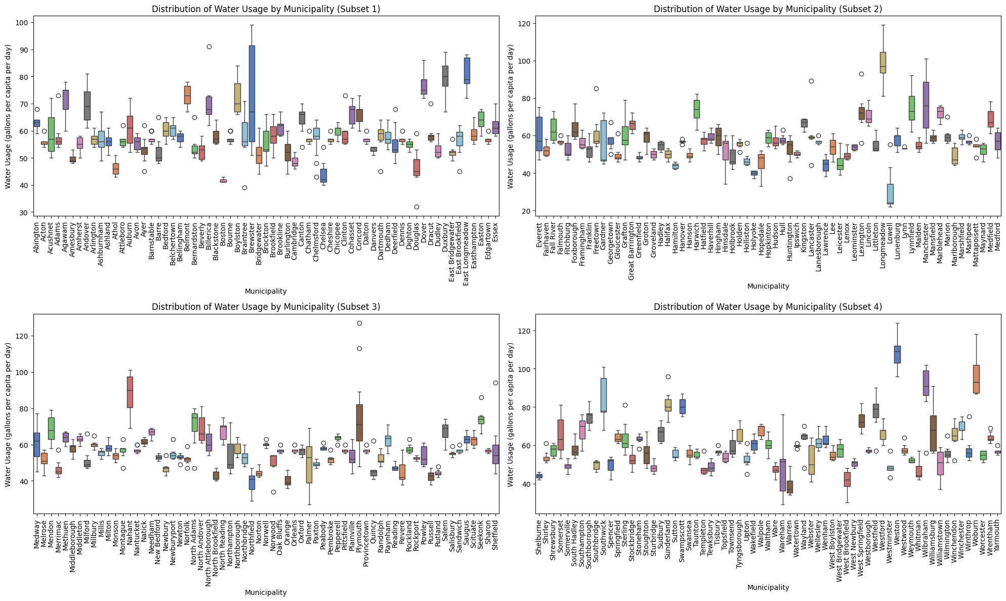
Box Plot - Distribution of Water Usage by Municipality

Slide 21
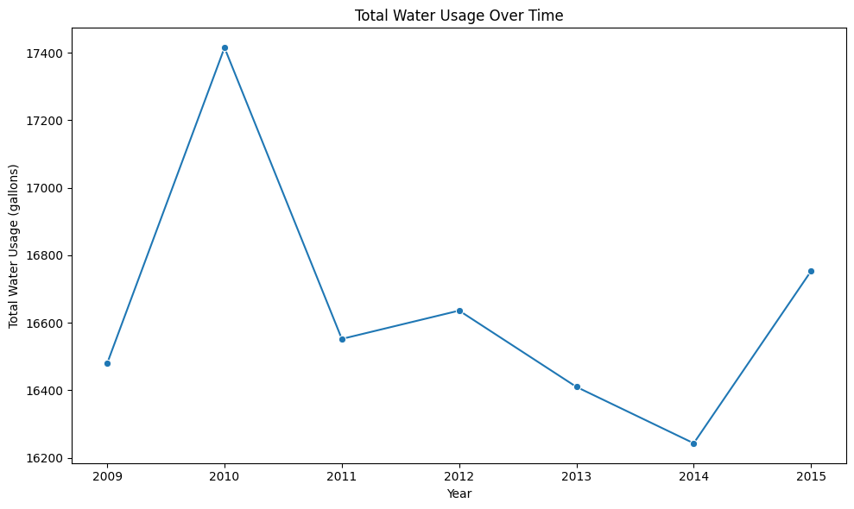
4. Line plot-Total water usage over time
This line graph illustrates the trend of total water usage over time from 2009 to 2015. The y-axis represents total water usage in gallons, while the x-axis displays each year within the range.
Key observations include:
Peak in 2010: Water usage peaked sharply in 2010, reaching over 17,400 gallons.
Decline and Fluctuations: After 2010, there’s a noticeable decline, with minor fluctuations through to 2014, hitting a low before a slight recovery in 2015.
Trend Insight: This graph helps identify patterns in water usage over time, which can guide further investigation into factors influencing these changes, such as population growth, policy changes, or environmental conditions.
This visualization is effective for showing changes over time, with line markers highlighting specific data points for clarity.

Slide 22
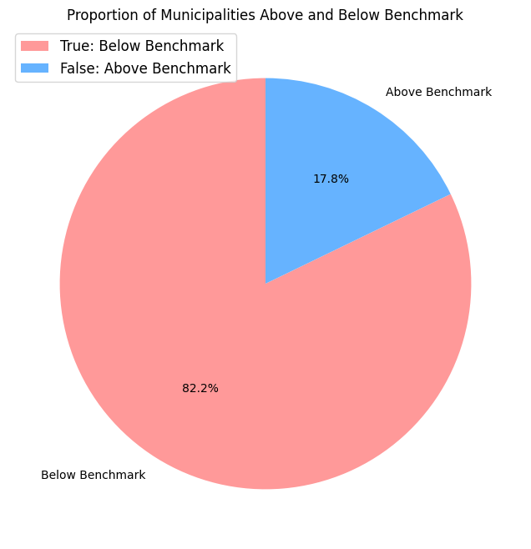
5. Pie Chart-Below/Above benchmark water usage
Proportion of Municipalities Based on Average Water Consumption
82.2% of municipalities are Above Benchmark (higher consumption).
17.8% are Below Benchmark (more efficient consumption).
Key Insights:
Above Benchmark: Most municipalities are using more water than expected.
Below Benchmark: A smaller group is using less water, possibly adopting efficient practices.
Markers Used:
Pie Chart Segments: Represent Above and Below Benchmark.
Legend: Explains True (Above) and False (Below).
Labels: Show categories and percentage values.
Channels Used:
Color:
Above Benchmark: #ff9999 (soft red)
Below Benchmark: #66b3ff (light blue)
Size: Segment size proportional to percentage.
Text: Labels with exact percentages displayed inside the segments.

Slide 23
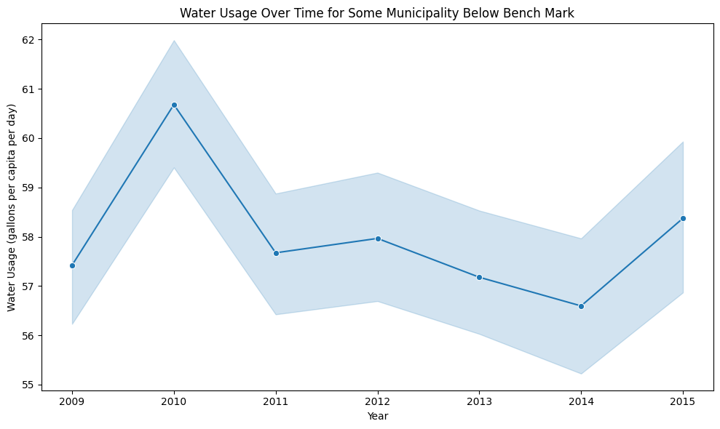

Time Series Abington and Weston Municipalities
Abington and Weston were chosen for its consistent performance below and above the benchmark level, indicating difference in effective water management practices.
The charts display water usage (gallons per capita per day) for Abington and Weston from 2009 to 2015.
Key Observations:
Trend: A peak in 2010, followed by a gradual decline until 2014, with a slight increase in 2015.
Markers: Each year is marked with a point to emphasize individual data values, making yearly comparisons clear.
Channels Used:
Position (Vertical Axis): Shows water usage values for each year.
Position (Horizontal Axis): Represents time progression from 2009 to 2015.
Line: Connects data points to illustrate the trend over time.
Shading (Confidence Interval): The blue shaded area around the line shows variability, indicating the range within which values may fall.
Text: Titles and axis labels provide context for interpreting the chart.

Slide 24
CONCLUSION
Trends in Water Usage:
Overall Trend: From 2009 to 2015, Massachusetts municipalities showed fluctuating water usage, peaking in 2010 with an annual mean around 60.68 gallons per capita per day (rgpcd), then gradually decreasing to a low of 56.60 rgpcd in 2014.
Benchmark Comparison: The Massachusetts state standard for residential water use is 65 rgpcd.
Above Benchmark: 82.2% of municipalities exceeded this benchmark, indicating a majority with room for improvement in water conservation.
Below Benchmark: Only 17.8% of municipalities, such as Abington, managed to stay consistently below the benchmark, suggesting effective water management practices.
Municipal Performance - Abington Case Study:
Abington's Trend: Abington displayed a downward trend from 2010 (around 60 rgpcd) to 2014 (approximately 55 rgpcd), with a slight uptick in 2015.
Effective Management: Abington’s performance is notable, consistently below the benchmark, making it a potential model for efficient water usage among Massachusetts municipalities.
Visualization and Analysis:
Bar and Box Plots:
Average Water Usage Comparison: Bar plots compared municipal water usage, with Abington among the lower usage figures, highlighting disparities.
Variability and Outliers: Box plots showed central tendency and spread across municipalities, identifying several outliers with notably high usage.
Time Series with Confidence Interval:
The time series analysis with confidence intervals displayed the variability around annual trends, emphasizing certain years (e.g., 2010) with higher uncertainty, suggesting external influences on water usage patterns.

Slide 25


